Slide 1
Building resilience Developing your own plan
If you have not already done so, please take the free VIA survey at www.viacharacter.org
All Workplace Strategies resources are available to anyone at no cost, compliments of Canada Life.
Notes:
FACILITATOR INSTRUCTIONS: If you are unable to have this completed in advance, considering adding 15 minutes to your presentation to allow participants to complete it on their devices in session. Ensure you provide access to WIFI for those with limited data plans and offer alternatives for those without a device.
_______________________________________
TIMING:
The ideal time for the entire session would be 3 hours with two 10 minute stretch breaks after each hour.
If you only have 2 hours, skip the Coping Strategies Planner and Be Aware of Resources and ask people to complete on their own time.
If you have both students and employees it is recommended that you also suggest they complete the Work Resilience section on their own time. Alternatively, the students can do 3 versions of the 4 A’s while employees complete the Work Resilience.
If you only have 1 hour, you may want to skip the background slides (4-11) and explain the 4 A’s but leave it to be done on their own time. Just briefly explain the rest of the slides, but take the time to have them choose one of the Commitments for themselves before wrapping up.
________________________________________
OPENING
Hand out either Plan for Resilience (employed) or From Thriving to Surviving (students) - Invite people to check that they have the workbook that is most relevant to them:
If under the age of 20 or if a full time student, From Surviving to Thriving is likely more relevant
If working, or over 30, Planning for Resilience is more relevant
If you’re between 20 and 30, working or not, and not in school – you choose
Welcome participants to your Traditional Territory (use appropriate wording for your territory; check with a community elder if possible)
Housekeeping – point out exits and let people know where washrooms are and when you will be taking breaks
If you have time, tell a story of resilience related to your experience.
One example is a caregiver who was overwhelmed with caregiver responsibilities and was being pressured to place a loved one in a nursing home. The caregiver exhibited resilience by taking time away to reflect and come up with a plan to continue to be the caregiver, which included solutions (such as hiring a nanny) that no one else had thought about – as opposed to continuing to be stressed and not making a decision.

Slide 2
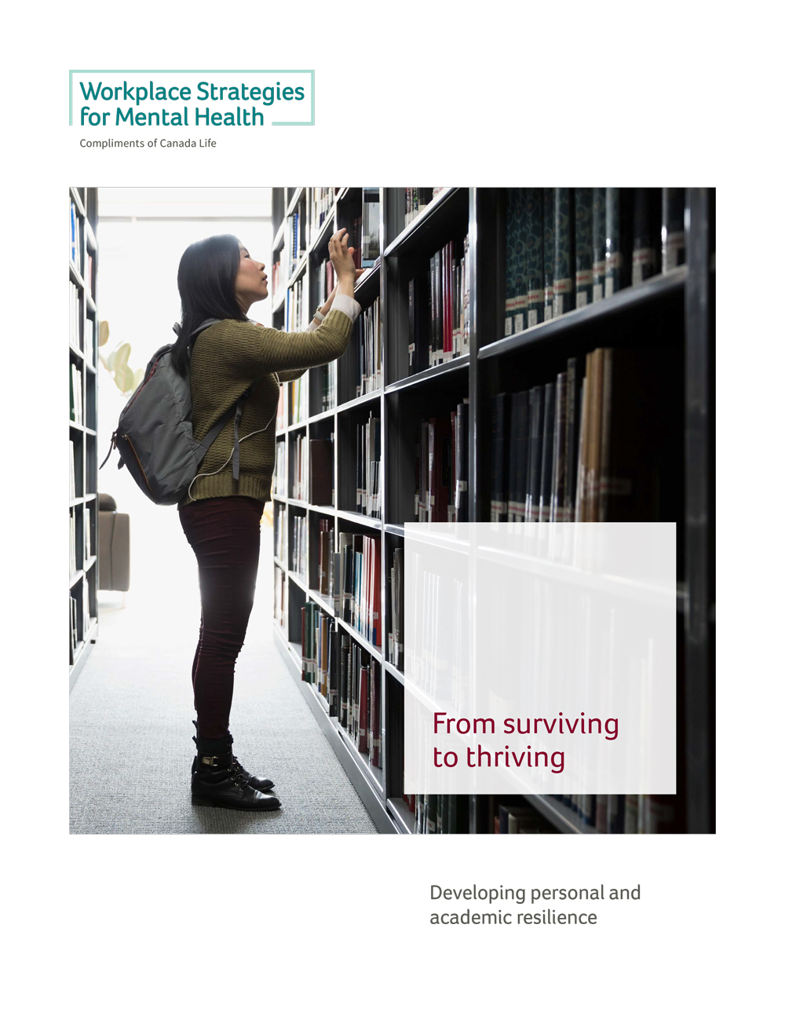
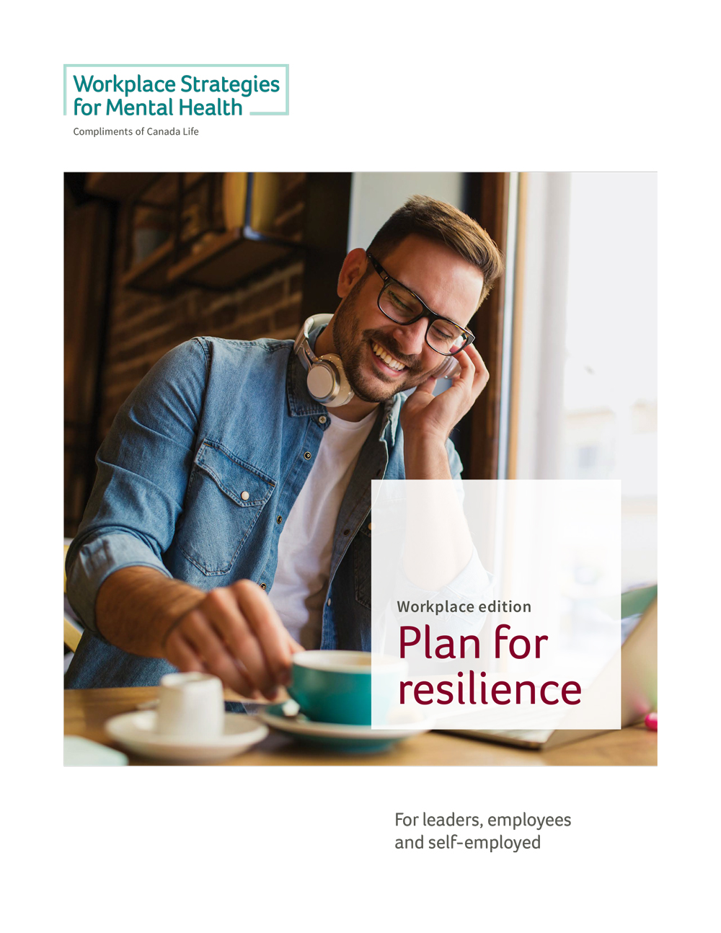
Choose your version
Post-secondary
students
Leaders, employees,
self-employed
Notes:
If this is a mixed group, invite people to check that they have the workbook that is most relevant to them.
If under the age of 20 or if a full time student, From Surviving to Thriving is likely more relevant
If working, or over 30, Planning for Resilience is more relevant
If you’re between 20 and 30, working or not, and not in school – you choose

Slide 3
This is not a medical or crisis intervention tool
It is for building resilience when well enough to do so
Notes:
FACILITATOR INSTRUCTION: Please ensure that at this point you are able to provide a text, phone or location of someone available throughout this session who can help those who are currently need assistance or support.
Important distinction – this is not therapy or a medical intervention. If you are in crisis now or very unwell, our suggestion is to take this to your treating professional to complete together when you are well enough to do so.
Taking part in this session will be fine but it is not fair to be expecting yourself to develop healthier coping strategies when you are struggling to get through the day. It is like asking you to develop new math skills during the math exam. It is not great for your stress levels. So, if this is your situation, just relax and take from this whatever resonates with you.

Slide 4
Is resilience just a way to blame the victim?
Notes:
Is resilience just a way to blame the victim?
Some used to think so because of the way they heard it referred to: We will continue to have a toxic relationship or workplace or classroom and you just need to become more resilient to put up with it. This was sometimes said to people who were bullied, teased, humiliated, or pressured with unreasonable demands: You need to suck it up or toughen up. You need to be more resilient and less sensitive.
In other words – let’s blame the victim. But we may have missed the point of resilience…

Slide 5
Resilience is the capacity to adapt or recover in the face of:
Adversity
Trauma or tragedy
Threats or harassment
Stress or overwhelm
Relationship problems
Financial problems
Health problems
Work or school issues
Notes:
Many of these things are part of life. We will not be able to avoid them all. So, rather than see resilience as blame the victim, begin to see it as empower the human.
Regardless of your life circumstances or your workplace, building your own resilience will allow you to have a better quality of life. You deserve that.

Slide 6
Burnout
No mental reserve
Lack of appreciation
Blindsided by betrayal
Notes:
As we reviewed the research around resilience, we understood that it could help prevent burnout, which can be characterized as depletion of energy.
Many people who burned out were literally, burning the candle at both ends by constantly over extending themselves. This is why at some point, they had no reserve of mental energy to deal with what they were going through.
A lack of appreciation is another common theme. Most felt they were neither recognized or appreciated for their efforts.
In fact, those closest to them may have resented the energy they spend on work or pursuits that did not include them. This can lead to the added stress and strain of conflict in personal relationships.
Another interesting observation is that many people who burned out continued pushing their limits for years or even decades. The crash point often came when they feel blindsided by what feels like a betrayal or someone questioning their integrity.

Slide 7
Traumatic incident
Powerless
Intentional cruelty/blame
Unexpected
Notes:
We then looked at research related to who is more likely to experience PTSD. It explored why some people seem to be able to face horrific trauma, but bounce back from that.
You guessed it — resilience
Those who become disabled with PTSD or overwhelming anxiety after exposure to a traumatic incident, often report feeling powerless in the moment.
What makes that worse is when they perceive that someone was being intentionally cruel in causing the trauma. This may lead to the unsettling fear that intentional cruelty is everywhere.
Another common experience for those experiencing PTSD, is being blamed – either directly for the traumatic incident or indirectly through a poorly worded question such as: Why didn’t you do this or that?
The impact of this blame can be devastating if internalized. An example might be a paramedic who is used to seeing trauma but wasn’t expecting to come upon an accident scene where they were unable to save a child that was the same age as their own. If upon return to the station they are asked why they didn’t follow standard operating procedure, they may internalize that as blame, when in fact it might just be a debrief that discovers they did everything to the best of their ability in the situation.

Slide 8
Conflict or bullying
Assumptions
Cruelty
Misperceptions
Notes:
We also looked at the many people who are shaken to the core by conflict, a breakup, or bullying. Some are so affected by this situation that they are off work or miss classes due to stress-related illness.
We know from WorkSafeBC who cover some claims for bullying, and from Workers Safety and Insurance Board (WSIB) who cover some claims for chronic mental stress at work, that the vast majority of claims are denied.
This is because even though the situation was so unbearable that a claim was filed, they were not able to confirm that the actions of the accused were the main reason for the only reason for the development of a mental health condition or because the motives of the accused may not have been clear. In any case, it leaves both the accused and the accuser without a healthy resolution.
What might have changed this outcome for these claimants by allowing them to resolve the situation successfully? You guessed it again — Resilience.

Slide 9
Common elements can break us down
cruelty
powerless
misperception
blindsided
unsupported
Uncertainty
overwhelmed
unexpected
assumptions
unappreciated
Notes:
RRWhen we put all the elements of burnout, trauma and conflict together, we can see their commonalities.
And we can see how these things have the potential to break any of us down over time – especially if we are already vulnerable due to health, family, financial, work or school pressures.

Slide 10
Common elements can help build resilience
Self-awareness
Anticipate challenges
Develop strategies
Social connections
Notes:
But there’s good news.
Resilience also has common elements that can be protective. We can learn and develop resilience to help us bounce back from most if not all of these things.
It can’t prevent us from being exposed to stress, conflict, or trauma – but it can help us recover faster and with less emotional or physical damage.

Slide 11
Post-traumatic growth
Notes:
In fact, resilience can do more than minimize harm.
It can help us to learn and grow from life’s challenges.
You have likely heard about Post Traumatic Stress Disorder, but how many have heard about Post Traumatic growth?
I bet you’ve seen it – that person who seems to have dealt with extraordinary loss or tragedy, yet still seems to embrace and be grateful and joyful for their lives.
Nelson Mandela, Mother Theresa, and yes even Monica Lewinsky to name just a few.
So let’s build resilience not to put up with others who are toxic, but to have the ability to move beyond them or at least prevent them from taking away our joy.

Slide 12
Recognizing your automatic responses to stress
In school – p. 8-12
At work – p. 8-12
Notes:
Next we’re going to have you open your workbook to the page entitled Recognizing Your Automatic Responses to Stress.
You’ll begin completing it based on your own situation.
FACILITATOR INSTRUCTION [Please ensure that you share this before any workbook writing begins]:
Unless instructed to do so, please don’t share your answers. It is purposefully meant to allow you uncommon time for quiet reflection about you!
Of course, you can share whatever you wish with whoever you wish when we are done.
We will have time to share and talk about strategies later.
________________________________________________________________
Why this matters (from page 4 of Plan for Resilience)
For most of us, stress is a daily occurrence. Often, our responses to stress are automatic. This means that we don’t choose them or plan them. However, if we can identify some of our immediate responses to stress, we are more likely to recognize and address them before they create a major life or health concern. Most of us will have automatic physical responses as well as changes in our behaviours and emotions.
Always eliminate the possibility that any of your responses may indicate an unrelated or underlying health issue that should be checked out with your doctor. Once you know it is stress related only, you can use that information to help identify the source of stress earlier and make changes sooner.
Understanding the automatic stress responses of others can be very important information for us as well. When we recognize a stress response in others we are less likely to take their behaviour personally. In recognizing that this is their defence mechanism to deal with their own stress, we are less likely to feel the need to defend ourselves. In fact, we may be able to help them deal with it. For example, you may have a friend who needs personal space or they become agitated. Once you know that, you can see the agitation and step back to give them space or help them move to a better location.
Instructions
Read each of the responses and potential impacts on the following pages. Check off your usual responses when you are experiencing stress and think about the responses you may have seen with others. It may be in the very first moment of stress or after prolonged or chronic exposure.
The following categories include physical, emotional, and behavioural responses. If you have a response that is not listed, please add it under the heading “Other”.
**Allow 3 to 5 minutes for completion
Wrap-Up – You may have noticed:
Identifying your potential physical, behavioural, and emotional responses to stress before they happen, can help increase your ability to recognize when you are having a stress response.
This can enable you to reach out for help earlier, which may lessen the negative impact of stress on your work and health.
You may also have noticed that some of these automatic responses are things other people do that you may have attributed to their personality or character when in fact it may be a stress response for them.
For more information and resources related to the stress response you can go to the link at the bottom of page: https://www.canada.ca/en/public-health/services/chronic-diseases/ cardiovascular-disease/reduce-stress-level.html

Slide 13
Choosing healthier responses to stress
In school – p. 13-14
At work – p. 13-14
Notes:
We’re now going to complete the section Choosing Healthier Responses to Stress.
You’ll choose some of these healthier responses to incorporate into your daily or weekly routines:
Why this matters
There are many strategies that can help reduce the negative impact of stressors. The following list includes potential strategies to help prevent or manage stress. Many are evidence-based approaches, such as mindfulness, practicing gratitude, and deep breathing. Others are practice-based approaches shared by those who used them successfully to manage their own life stressors.
Not all of these strategies will work for everyone. In fact, some may cause you stress because they are not calming or enjoyable to you. Others may have neither a positive nor a negative impact.
Instructions
Check off the strategies below that you know work for you.
Put a checkmark by the strategies that you think might be helpful and that you are willing to try. Pick some key ones for you – many strategies may look interesting, but focus on those you feel you will have time to work on.
When you’re done, share with the people at your table the ones you already use successfully and learn the strategies that have worked for them.
**Allow 3 to 5 minutes for completion
Wrap-Up – You may have noticed:
By including healthier responses into your regular activities, you not only help build resilience, you may be able to help alleviate stress in many different situations.
Choose healthier strategies in times of personal stress.
Take Your Break offers healthy activities you can do alone or with others in 15 minutes or less in most settings. Check out the link at the bottom of the page:
https://www.workplacestrategiesformentalhealth.com/newsletter/Healthy-Break-Activities

Slide 14
Recognizing and exploring your stressors
In school – p. 15-18
At work – p. 15-18
Notes:
FACILITATOR INSTRUCTION: This section is the one we need to carefully set up and debrief. Please include all of the intent of the following wording, even if you say it in your own style.
Next we’ll be looking at the section Recognizing and Exploring Your Stressors.
Why this matters
Resilience is the ability to bounce back after being blindsided or overwhelmed by adversity. One of the ways to improve our ability to bounce back is to be fully aware that challenging and difficult events could happen to any of us at any time and proactively consider how we might cope with them.
This is not intended to increase anxiety about what could go wrong, but to recognize that many people have experienced these life events and successfully moved forward with their lives.
For example, most of us know individuals who have experienced serious illness, disability, or loss and then bounced back to enjoy and appreciate life more than ever. We probably also know people who experienced a setback or disappointment many years ago, yet continue to experience anger or hurt about it every day. Our quality of life is directly affected by our ability to move forward from a crisis in a way that supports our own mental well-being.
Instructions
The items listed on the following pages can be significant life stressors. They could happen to you or someone you care about.
There may be times in life when we have many different stressors, but are managing quite well. There may be other times when we only have one stressor but it is overwhelming. There is no ideal number of stressors and no right or wrong way to feel about them.
Life is very fluid and can change at any time. We want to build resiliency to cope with any and all of life’s stressors, but this is a lifelong learning activity. We will start with whatever is most relevant to you right NOW.
Check any items that you are dealing with now or know you will in the very near future.
At the end choose one of your stressors to explore further for potential solutions later in this session.
Complete right up to the end and then read the section titled “ Please don’t compare your stressors to anyone else’s”
**Allow 3 to 5 minutes for completion

Slide 15
Each ‘A’ is a potential option when dealing with a specific stressor
Accept
Avoid
Stress
management
Alter
Adapt
In school – p. 20-24
At work – p. 20-22
Notes:
We have choices when it comes to dealing with stress and adversity. These choices can usually be classified as one of the four A’s: Accept, Avoid, Alter, or Adapt. The following is adapted from https://wellness.uchicago.edu/healthy-living/health-information/stress/. [Note that this link is an update to 2019 versions]
Less helpful strategies
Some people turn to alcohol, food or other substances when they are stressed. This can help distract us from whatever is causing the stress, but it rarely makes things better and can often make things worse.
Others will step back and take time to consider potential approaches to addressing the cause of their stress.
This can provide an opportunity to reduce the stress and gain perspective about what can be done.
We can use the 4As shown here to help us do just that with any of the stressors we’ve identified.
*Adapted from Mayo Clinic Staff (2016). Need Stress Relief? Try the 4 A’s. Retrieved from https://www.mayoclinic.org/healthy-lifestyle/stress-management/in-depth/stress-relief/art-20044476?pg=2
Recognize that valid choices are those that can eliminate or significantly reduce your stress.

Slide 16
Accept the things and people you really cannot change
Don’t try to control the uncontrollable
Look at challenges as opportunities for personal growth and learning
Share your feelings to help reduce their power over your emotions
Learn to forgive and move on
Notes:
Sometimes the best way to deal with a stressor is to accept it. As hard as it may be, accepting what is not possible to change (rather than desperately or hopelessly wishing it were different) allows you to manage your stress more effectively.
It can also help to see our ability to accept and rise above a challenge as a way to learn and grow. So you didn’t get that special assignment you’d hoped for? What did you learn from the process of applying that you could you do differently and smarter next time?
Talking about it helps. Simply telling someone you’re not at your best is a way to open up the conversation and reduce the hold your emotions might hold over you.
For more on forgiving someone who has hurt you, check out the late Dr. Wayne Dyer’s blog at the link provided: https://www.drwaynedyer.com/blog/category/forgiveness/

Slide 17
Avoid unnecessary stress
Learn to say “no” and have boundaries
Avoid people who create a stressful environment whenever possible
Establish a low-stress workspace
Prioritize your “to-do” list and dropping tasks or activities that aren’t truly necessary
Notes:
Avoid unnecessary stress. Not all stress can be avoided, and it may even be unhealthy to avoid stressful situations that need to be resolved. However, when appropriate, try to avoid unnecessary stress.
Saying no can actually be incredibly empowering. Consider how good you feel once you’ve made the decision to not do something that wasn’t serving you in some way.
Being aware of and avoiding people who may act or live in a way you find stressful is a way to set boundaries but also invest in your own well-being. You shouldn’t feel guilty about your decision to eliminate or reduce the time you spend with such people if it’s a constant drain you’d be better without.
Take time to do whatever it takes to make your workplace comfortable and more relaxing. That might mean clearing away unnecessary clutter, or reducing trinkets and photos to just those that brighten your day!
Write and stick to your to-do list. Make sure it’s things you really need to do and drop the rest.

Slide 18
Alter the external situation
Modify your environment
Change your routines including what you consume, how you move, what you watch, and where you go
Set boundaries in your relationships
Notes:
Alter ways you can communicate and operate in your daily life to minimize stressors.
Find safe people and places where you can open up about your stress. Take a walk with a trusted colleague or friend and let it out – but try not to just make it a complaining session. What’s the positive spin you can put on this?
Take pressure off yourself in intentional ways. What’s the worst thing that will happen if you don’t spend another hour on that report tonight?
Tell people when a situation is causing you stress. Tell them what you need for it to be healthier for you. That may mean you need to close your office door or barricade the entrance to your cubicle for a while or maybe you need people to move their talking and socializing out of your hearing range so you can focus and relax in your own way.
While many of us will continue to work around the clock, planning just five minute breaks every hour can make a world of difference. Think about how you can plan your day to allow for this. Avoid getting sucked into time wasting conversations or email trails.

Slide 19
Adapt your internal thought process
Reframe problems as a desired solution (“I don’t sleep enough” reframed as “I need to improve the quality of my sleep”)
Consider potential consequences of taking various actions — look at the big picture
Set clear and reasonable expectations and standards for yourself
Notes:
Adapt to the stressor by changing your attitudes and behaviors.
Focusing on solutions is actually a lot easier and more positive than focusing on problems. You know you’re tired – so why not just plan to always get more sleep.
Often when we’re stressed we want to take action but we fail to see that certain actions can create new stressors. Angrily confronting someone is just going to break down the relationship and may cause you to say something you’ll regret later.
Lowering the bar to a reasonable level can sometimes have astonishing results. Keeping work or studying within reasonable daily limits can allow you to engage so much more fully in the rest of your life, making you better at work and school.

Slide 20
Each ‘A’ is a potential option when dealing with a specific stressor
Accept
Avoid
Stress
management
Alter
Adapt
In school – p. 22
At work – p. 22
Notes:
Think about a specific stressor in your life right now and use the chart under BRIEFLY DESCRIBE THE STRESSOR FOR WHICH YOU WILL EXPLORE YOUR OPTIONS to consider how each of the 4 A’s – Accept, Avoid, Alter, Adapt – might make your stress better or worse.
**Allow 5 minutes for completion
Wrap-Up:
Perhaps you use a coping strategy that is more damaging than healthy or helpful. Considering all of the four A’s might help with managing your perspective of the situation and improving your stress level. The 4 A’s are used by many schools, businesses, and organizations because they work.

Slide 21
Balancing your support network
In school – p. 25-27
At work – p. 23-25
Notes:
We’re now going to complete the section Balancing Your Support Network
Let me ask you a few questions…
How do you feel after you help someone?
If you are happy to help others and feel good doing it, do you also feel good about asking for help? If not, why not?
Some of us were raised to believe that helping others was a sign of strength but asking for help was one of weakness.
But do you actually think people who ask for help are weak? Probably not.
Resilience involves our need to connect with one another.
All of us will have times when we can offer help and times when we should reach out for help.
There are times we need to be supported and times we need to be supportive.
Asking for help in our personal or work lives is one of the ways we can improve our resilience.
You may discover that there are more people than you were aware of who would be willing to help you. But not everyone can help with every issue. If the first person you reach out to is unable or unwilling to help, try someone else.
If you feel hesitant to reach out, think about how you feel when you are able to help someone. Many people welcome the opportunity to help and are relieved to find out that we all need help from time to time.
Instructions:
Think about family, friends, associates, colleagues, neighbours, or services you could reach out to for help.
On the left side of this chart, list the names of people whom you can or do support for each specific task that is listed in the center column.
On the right side, list the names of people who could provide that support to you.
Try to include a variety of names so that you can create a diverse network of support for yourself.
**Allow 3 to 5 minutes for completion
Wrap-Up – You may have noticed:
You never have to be alone when you need support: there is always someone who really wants to help, including a professional or volunteer, or organizational and community resources that can be found in person, online, and over the phone. Take time to discover these supports now so they will be easier to find when you actually need them. And then when you need them, reach out.
The Government of Canada highlights varied supports: https://www.canada.ca/en/treasury-board-secretariat/services/healthy-workplace/workplace-wellness/mental-health-workplace/resources-employees-mental-health-workplace.html
You may have more support than you first thought. You might also notice that your support network is not as large as it could be.
This is not a popularity contest. We are fortunate if we have a few good people in our lives who will be there to help us.
To help develop your network, look for opportunities to use your strengths to assist others.
This can include joining a group, collaborating online or in person, volunteering, or finding one person who needs your help.
However you choose to build a support network, the more people you support, the more people who may also be there when you need help.

Slide 22
Using strengths vs. fighting weaknesses
In school – p. 28
At work – p. 26
Notes:
We’re now going to complete the section Identifying and Using Your Strengths.
Why this matters
When we talk about a person’s character, we are talking about the sum total of who that person is, which means how their thoughts, feelings, and behaviours shape who they are, how they see the world, and how they interact with the people around them.
Every person has character strengths. These are positive qualities that are part of who we are and come naturally to us.
It is much easier for us to use our strengths during times of adversity than to try to manage our weaknesses. For example, if patience is not your strength, trying to be patient when faced with a delay in a work project won’t be easy. On the other hand, if creativity is a strength, distracting yourself from the stress and frustration of waiting while you begin a new, creative project might be helpful.
Instructions
If you have not already done so, consider completing the free VIA Character Strengths Survey at www.viame.org. It will take you approximately 15 minutes. There is no need to purchase the full report to learn about your top strengths.
This survey is part of a research project, so you will need to provide personal information, including your name and email address for research purposes. Alternatively, you can just write down what you feel are your top strengths using the list found in Appendix A.
Once you know your top three strengths, write them down in the spaces provided in the chart and then add ways to use them to help you deal with challenging times. The first three are examples to help you get started.
****Allow 3 - 5 minutes for completion
Wrap-Up – You may have noticed:
We all have many character strengths, but we don’t all have the same strengths to the same degree. For example, while everyone has curiosity, it will be stronger in some people than in others.
Also, any strength can be overused to the point where it becomes a problem. Using the example of curiosity, not enough can make life boring - too much can make you seem nosy or intrusive.
Recognizing strengths in ourselves and using them wisely can help us improve our own self-confidence and build connections with other people.
More information and tools to help you use your strengths to thrive in all areas of your life can be found in the link at the bottom of the page: http://www.viacharacter.org/www/Reports-Courses-Resources/Resources/Character-Strength-Fact-Sheets

Slide 23
Work resilience or academic resilience
Students – p. 29-30
Leaders – p. 27-28
Employees – p. 29-30
Self-employed – p. 31-33
Notes:
If one of your stressors is concern about being off work due to illness or injury, you may want to fill out the appropriate section for you: Work Resilience for Leaders, Work Resilience for Employees, Work Resilience for Self-Employed at another time.
We won’t do those today, but we do know that some people who do burn out also believe that no matter how unwell they are, they must keep working.
This section is to help those overachievers with poor personal boundaries to learn that they can put things in place so that when they need to take a day off for health purposes, it will not create a disaster of epic proportions.
For those who think I may be talking about you, please return to this section when you can.

Slide 24
What is your commitment to yourself?
In school – p. 31-32
At work – p. 34-36
Notes:
We’ll now look at Commitment to Myself
Why this matters
At this point, we’ve explored how you might automatically respond in the face of adversity and have considered alternative responses or daily habits that could be more beneficial. Now you can commit to one thing that you are willing to do differently for at least three weeks to improve your own resilience. Each one of these is based on the evidence of what builds resilience, but each are microchanges that will be relatively easy for anyone to fit into a busy day. Just choose one at a time and don’t add the next one until you feel the first one is comfortably embedded in your daily habits.
Instructions
Choose one of the items listed on the page or create your own. I will briefly describe them to you:
One is to take time after every disappointment or challenge or frustration and consider what you have learned.
Another is to take the advice of Mel Robbins, author of the 5 Second Rule. She suggests you forget waiting for motivation to do what you know you should do and just say 5,4,3,2,1 and takeoff to do it. If you have trouble with procrastination, this may be the one for you.
Another one is simply to use the 4 A’s we discussed earlier and apply them to your stressors.
You could also choose the option to simply express appreciation as often as you can – whether it is thanking someone for opening a door or expressing appreciation for sunlight – be on the lookout for what is positive in your day. If your thoughts have been rather negative lately, this might be the commitment for you.
You could spend time examining your mistakes and recording what you learned to do or not do the next time.
Or you could just say yes – for 3 weeks say yes every time someone offers to help with work, at home or even in a store. Learning to accept help is an important element of resilience and if you are uncomfortable or unaccustomed to doing this you may wish to consider this one.
Finally, you could also choose to monitor and correct your own self-talk. If someone said some of the things we say to ourselves all day – you idiot, how could you be so stupid, and the like – we would probably have them up on harassment charges. If you do this to yourself a lot, this may be the one for you.
**Allow 3 minutes for completion
Wrap-Up:
Committing to a challenge and sharing your plans with someone may help keep you accountable to your goals. Limit your stress by choosing only one change to work on at a time.

Slide 25
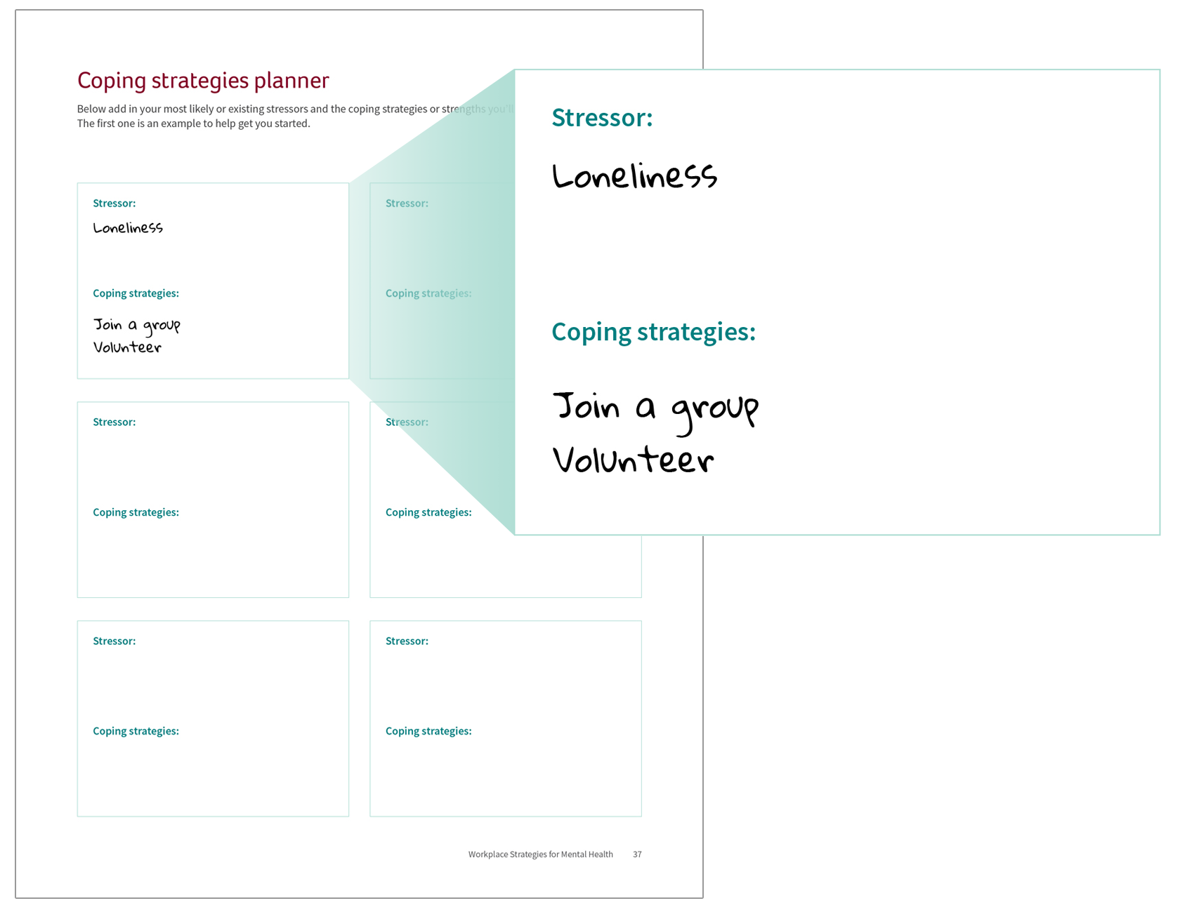
Coping strategies planner
In school – p. 33
At work – p. 37
Notes:
The Coping Strategies Planner is also provided for you to add in your most likely or existing stressors and the coping strategies or strengths you will use to deal with them. The first one is an example to help get you started.
We’ll leave this for you to do on your own time, but it is a great visual reminder of the strategies you believe will work. At the time of extreme stress, it is not unusual that we forget what works.

Slide 26
Be aware of resources before you need them
In school – p. 34-35
At work – p. 38-39
Notes:
FACILITATOR INSTRUCTION: Please ask the organization to fill in as much of this as possible in advance. Ask for copies of the page to hand out and review with the participants. A separate form should be done for students and employees. If you are an external facilitator request that someone familiar with the organizational resources take 3-5 minutes to review the resources with the group. If this is not possible, you can say:
We’ve also provided a chart to help you be more aware of potential resources.
Fill this in on your own or obtain a list of resources available to you within your organization, community, or other associations before you need them.

Slide 27
Yes, these resources are really free!
Notes:
All of the resources freely available through workplacestrategiesformentalhealth.com for you to use anywhere, anytime.

Slide 28
For more resources check out: workplacestrategiesformentalhealth.com
Questions? Comments?
All Workplace Strategies resources are available to anyone at no cost, compliments of Canada Life.
Canada Life and design are trademarks of The Canada Life Assurance Company.
Notes:
Do you have any questions or comments you would like to share?
________________________________
ENDING
Thank you for taking the time to build your own resilience. Remember that this resource is free and you are encouraged to revisit it yearly as your stressors change and you become ready to try out new coping strategies.

